Slide 1
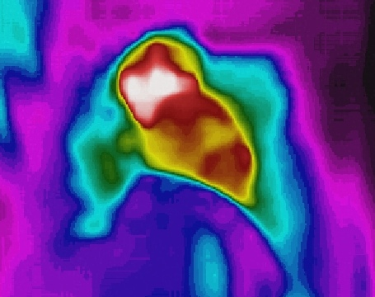
AIoT Bedroom
Au Ka Long(04)
Project ID: P21

Slide 2

Problem & Solution

Slide 3
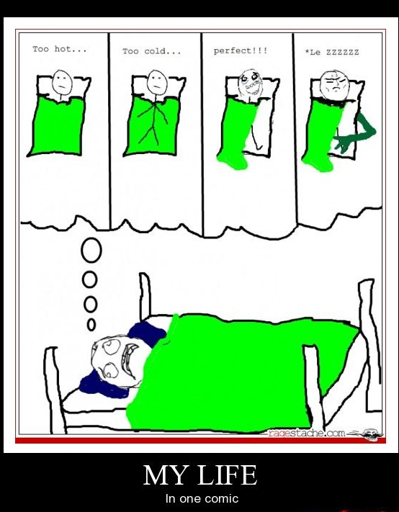
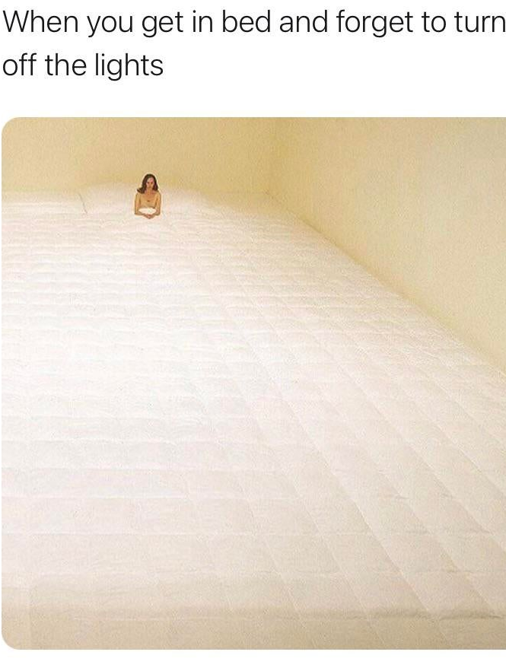
Problem
Find these problem from these memes
These problems are in our daily life
Try to solve them with AI and IoT

Slide 4



Furthermore
& ~30% of home accidents
Try to create a safe and relaxing place
Total relaxation
Worry-free
10-year average, Underlying Cause of Death 2014,CDC,http://wonder.cdc.gov/ ; SLIP, TRIP AND FALL ACCIDENTS: LIST OF SURPRISING STATISTICS:zhttps://callsam.com/blog/slip-trip-and-fall-accidents-list-of-surprising-statistics/, data from CDC,OSHA, etc.

Slide 5
Solution
Auto lights off when you are ready to sleep
Auto lights on when you are using phone
Auto change temperature of aircon when you are hot or cold
Auto call for ambulance when you get hurt and faint
Auto play music when you are on bed

Slide 6
Solution
Monitoring
Bedroom
Detection
Automation

Slide 7
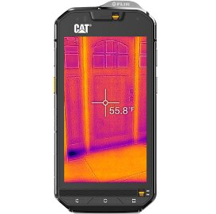
Actual technology Used

Slide 8
Simple Workflow
Socket
AI analysis (Yolo v5)
Software
Android App
Send data from Thermal Camera
PC
Get data
Visual image
Thermal image
Algorithms
Detection
IoT Automation

Slide 9
Simple Workflow
Thermal Camera
Thermal Image
Visual Image
Network
PC
CPU/GPU
Network
Hardware
IoT devices
Automation

Slide 10
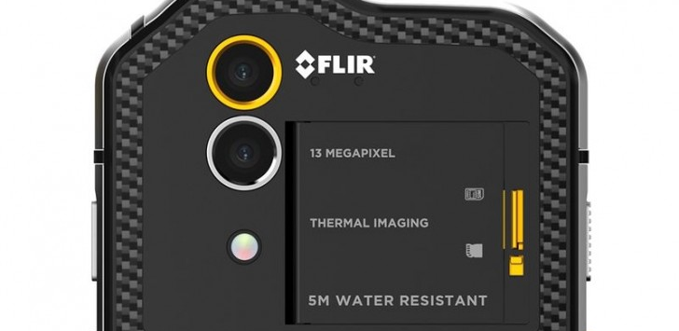
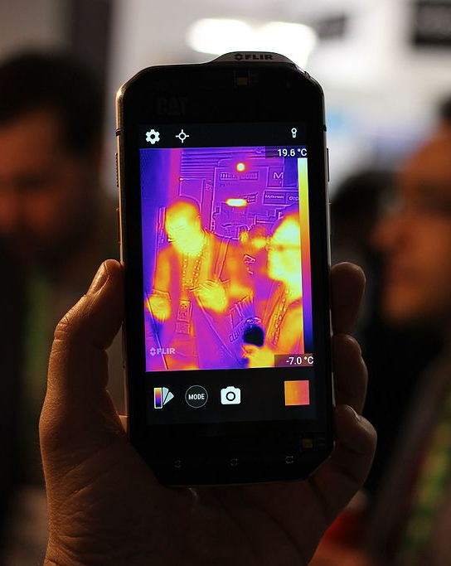
Hardware -------------------- Thermal camera
Thermal Camera
Visual Camera
Cat S60 is being used
Relative low price
Built-in WIFI
Android OS

Slide 11
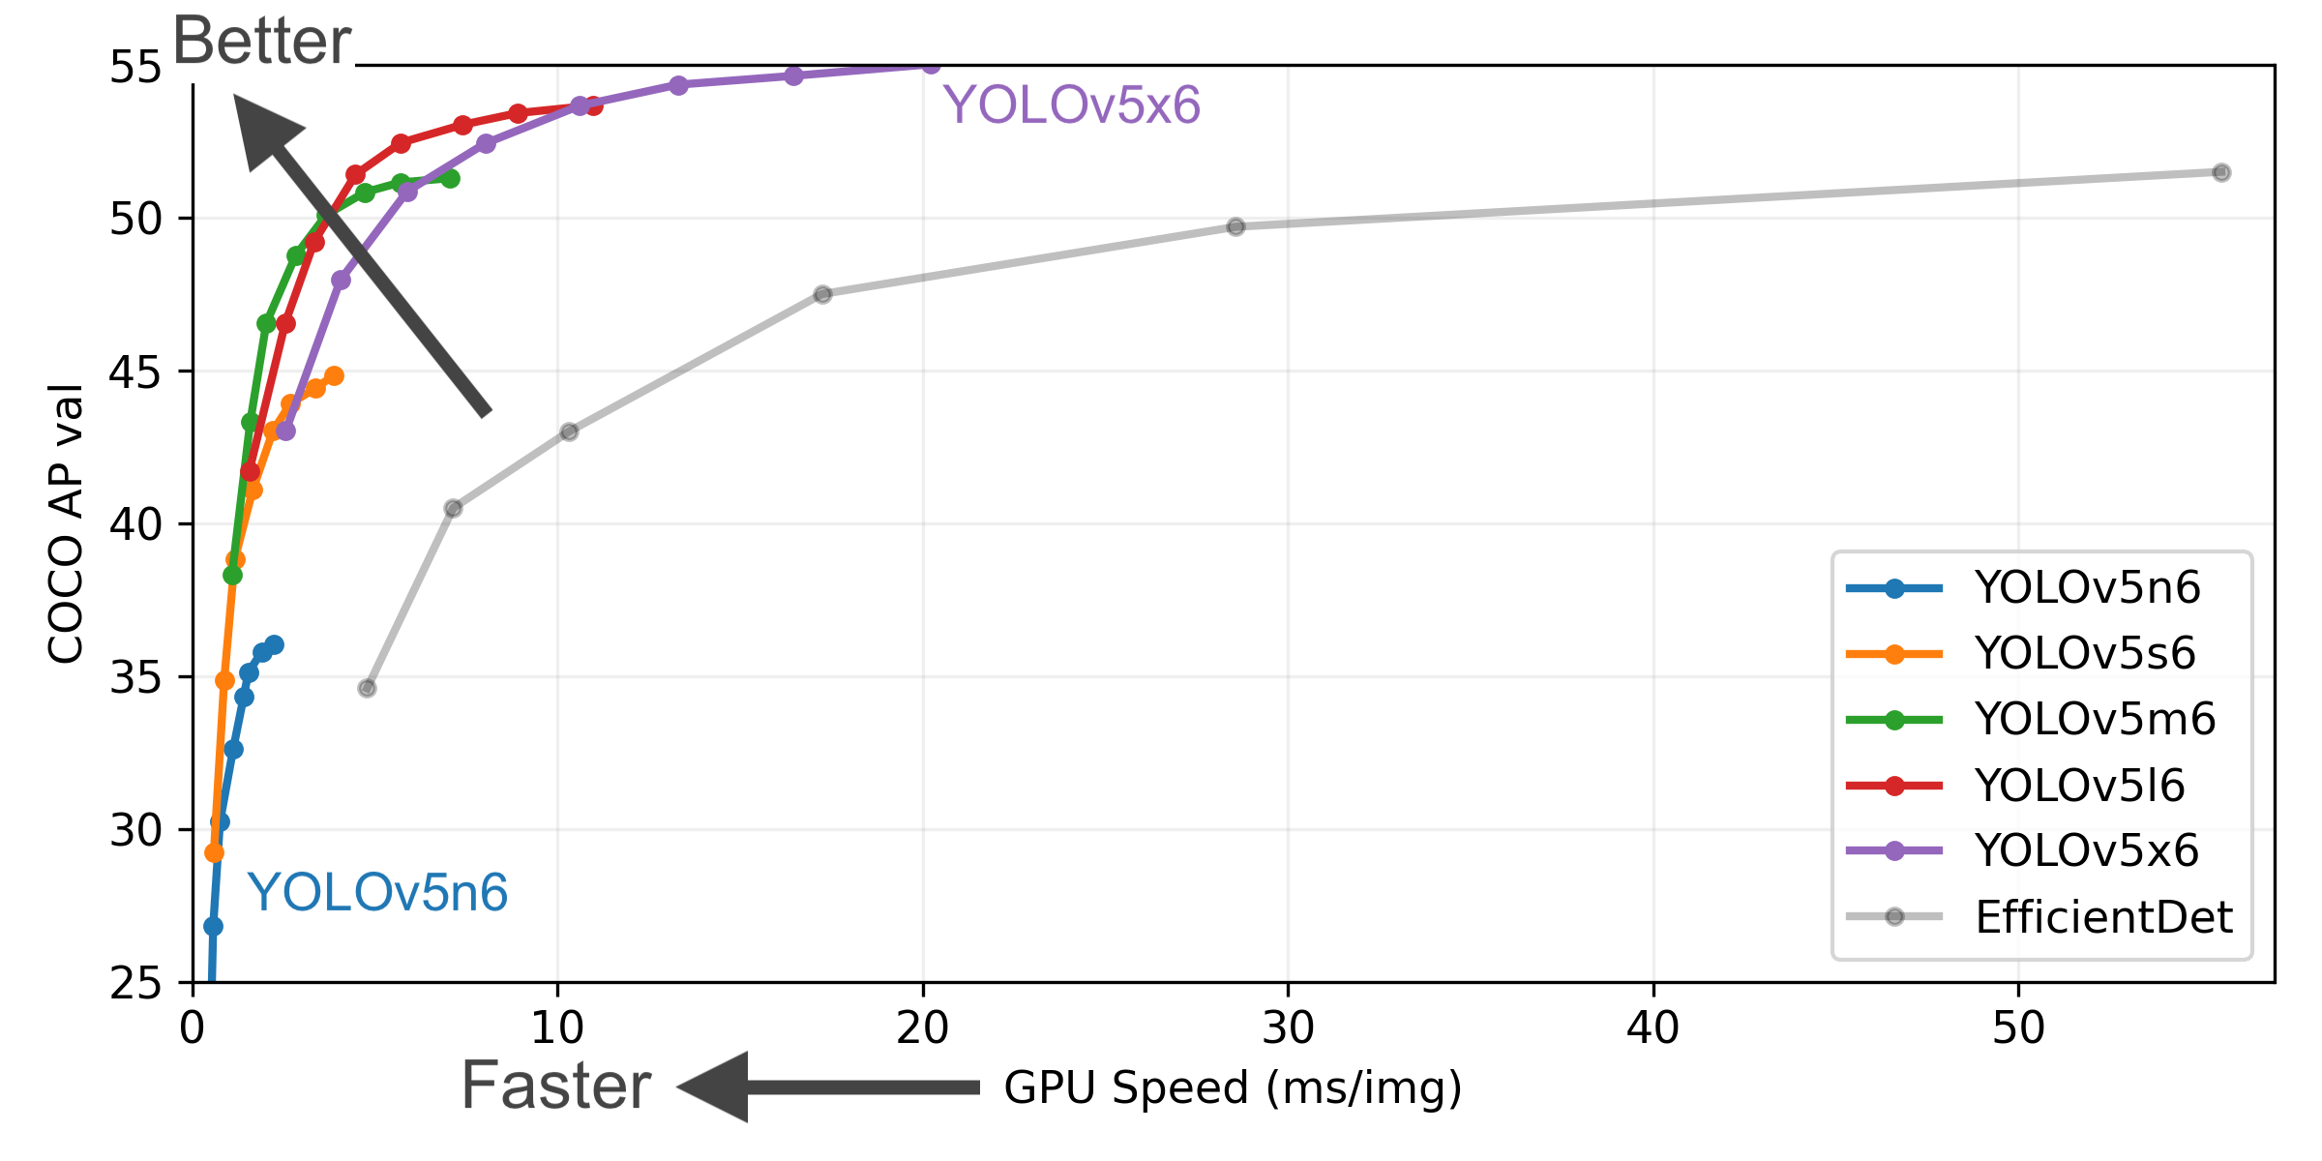
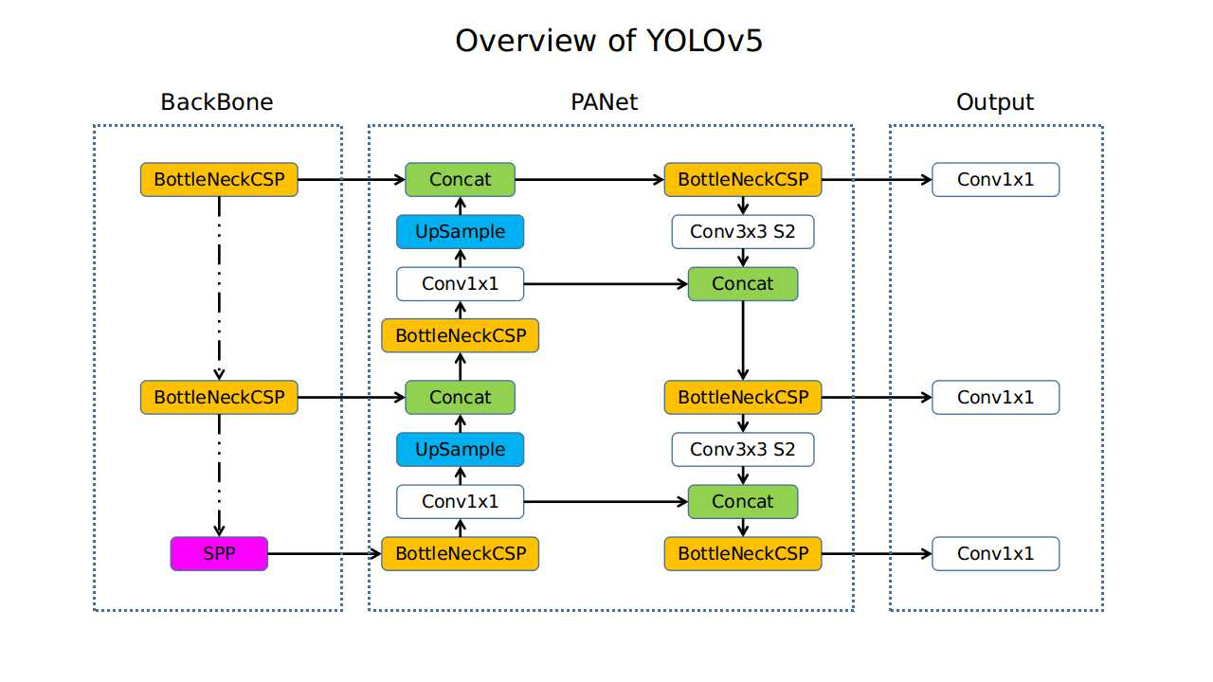
Detection(AI) --- YOLO v5
Model for object detection
One of the most reputable model
Quick and efficient
Note(in my project):
Only human, bed, phones are set to detect
Yolov5x6 is being use as default

Slide 12

Detection(Algorithms)
Sleeping detect algorithm
Bed lying detect algorithm
Using(touching) phone detect algorithm
Human movement detect algorithm
Bed temperature
Body temperature

Slide 13
Detection(Algorithms) --- Bed lying detection
Lying Detection
By ratios of human
Shoulder-height: 1:4
Adding some tolerance
Check whether obey this ratio
On Bed Detection
The percentage of human is inside of the bed
Check if is in an acceptable percentage
Proportions of the Human Body with Respect to the Height of the Head: https://www.researchgate.net/figure/Proportions-of-the-Human-Body-with-Respect-to-the-Height-of-the-Head_fig4_228867476

Slide 14
Detection(Algorithms) --- Sleeping mood

